Slide 1
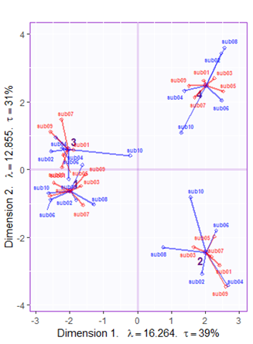
A) [NAME] - Mean Factor Score of Sessions & Partial Factor Scores of Subjects
C) DiSTATIS - Mean Factor Score of Networks & Partial Factor Scores of Sessions
Dimension 2 λ = 0.494 τ = 8%
Dimension 1 λ = 0.674 τ = 11%

Slide 2
DiSTATIS - Mean Factor Score of Networks & Partial Factor Scores of Participants
DiSTATIS - Mean Factor Score of Networks & Partial Factor Scores of Sessions
This is prob not needed
Dimension 2 λ = 0.494 τ = 8%
Dimension 2 λ = 0.494 τ = 8%
Dimension 1 λ = 0.674 τ = 11%
Dimension 1 λ = 0.674 τ = 11%

